Slide 1
CORONAVIRUS (COVID-19)
Getting Tested

Slide 2
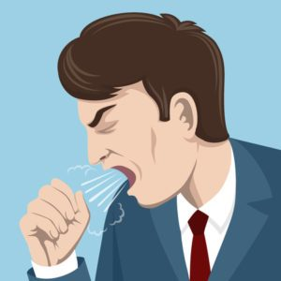
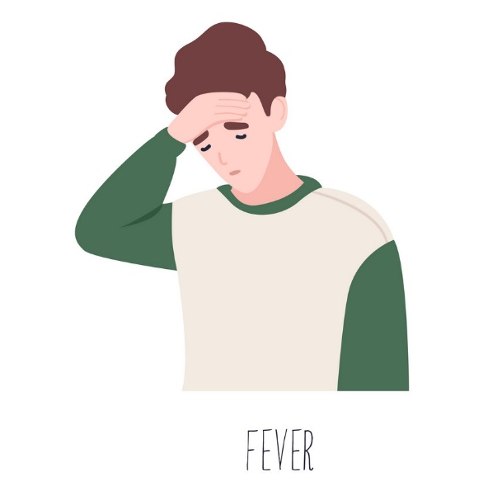
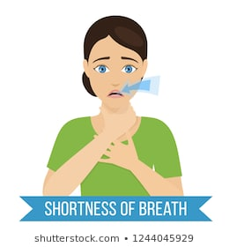
The coronavirus is similar to a flu or cold virus.
People who become sick from coronavirus may have
a cough, fever or shortness of breath.

Slide 3
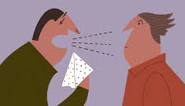
If I am feeling sick I may need to get tested for the coronavirus.
If someone I live with OR spend a lot of time with has the coronavirus,
I may also need to be tested.

Slide 4
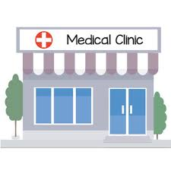
To get tested for the coronavirus I will go to a special clinic.
The clinic may be busy with other people who are also getting tested. If so, I may have to wait my turn.

Slide 5
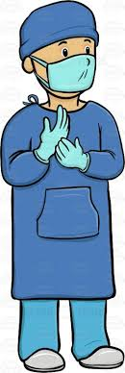
When it is my turn, a nurse will do the coronavirus test on me.
I will be asked to sit still and to remain calm.

Slide 6
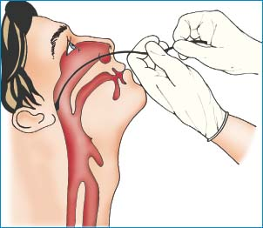
The nurse will place a swab (which looks like a large Q-tip) into my nose, twist it around and then remove it.
Nose Swab
Coronavirus Test

Slide 7
The test may be uncomfortable, but it will be over with quick.
It should take less than 10 seconds.

Slide 8
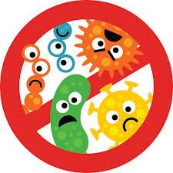
If I am sick and need to take the coronavirus test, it is really important that I do so.
Taking the test will help to keep me, my staff/family and other people in the community safe.

Slide 9
Learning about coronavirus testing might
make me feel different emotions.
It is okay to feel this way.

Slide 10
I have people in my life who are here to support me.
If I have questions or need support I can talk to them.

